Slide 1
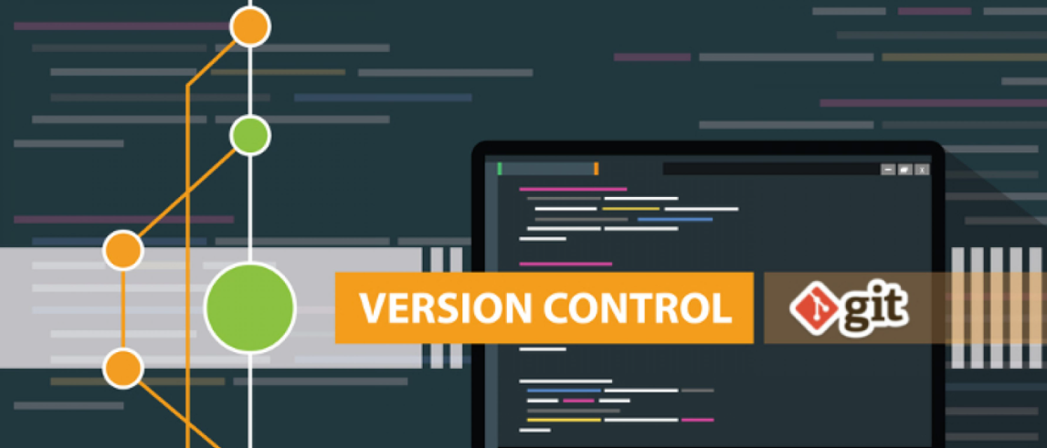





AGENDA:
DevOps - BRANCHING STRATEGY
DevOps - BRANCHING STRATEGY - RULES
DevOps – GitFlow v/s Trunk Based Development
DevOps – GitFlow | Essential Commands
DevOps – GitFlow | Key Benefits
DevOps – Git | Protecting Code Base

Slide 2
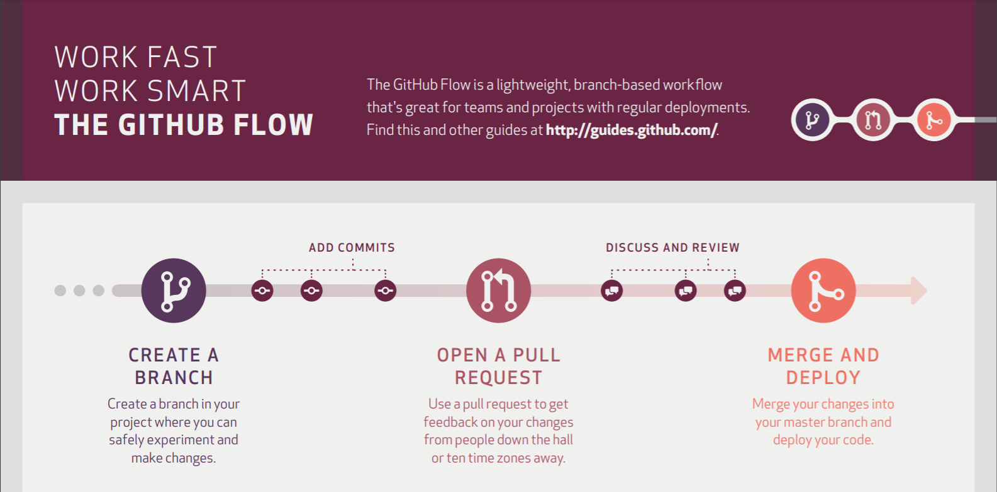
GitFlow Methodology

Slide 3

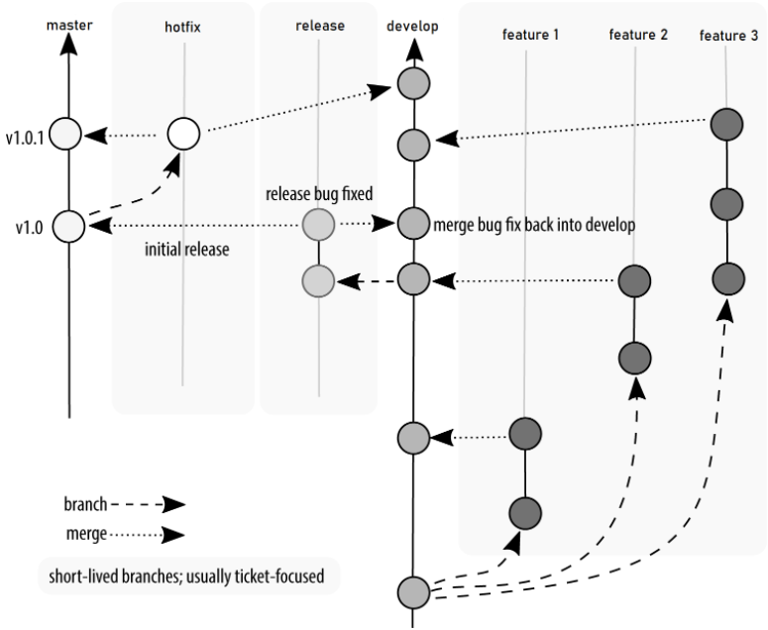
DevOps - BRANCHING STRATEGY
A “branching strategy” refers to the strategy a software development team employs when writing, merging, and shipping code in the context of a version control system like Git. Software developers working as a team on the same codebase must share their changes with each other. But how can they do this efficiently while avoiding malfunctions in their application? The goal of any branching strategy is to solve that problem and to enable teams to work together on the same source code without trampling on each other. A branching strategy defines how a team uses branches to achieve this level of concurrent development.
Gitflow is an industry standard branching strategy that supports goals we have for enabling parallel development and release of high-quality, features and fixes.
Gitflow defines a strict branching model designed around the project release & provides a robust framework for managing projects.
Branches
GitFlow Branching Model
MAIN
Supporting
BRANCHING REQUIRMENETS
Maintaining a branch in a repository for production-ready code, and don’t want to allow changes to this branch except from a select group of people.
Limit the number of people who can make changes to the default branch in a repository.
Ensuring that pull requests cannot be merged to a branch except by an approved group of developers/hierarchy.
Summary:
A good branch-merge strategy facilitates processes among multiple developers and is the basis for any well-functioning DevOps pipeline that uses continuous integration.
While there are many ways to implement CI and DevOps without a branch-merge strategy, most mature organizations use them to shift code defects left and reduce the negative impacts of a defect for those working on the particular change.
Master
Develop
Release
Feature/Bugfix
Hotfix
High-Velocity Development
MAIN BRANCHES
Master
Develop
SUPPORT BRANCHES
Next to the main branches master and develop, our development model uses a variety of supporting branches to aid parallel development between team members, ease tracking of features, prepare for production and to assist in quickly fixing live production problems.
Release
Feature/Bugfix
Hotfix

Slide 4
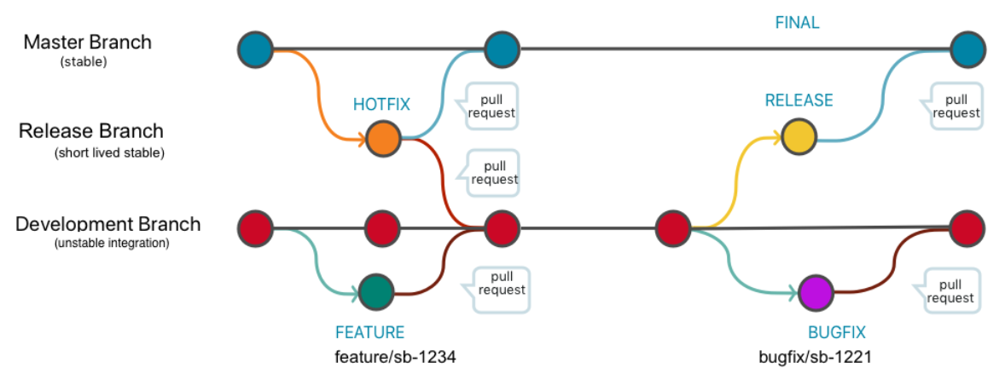
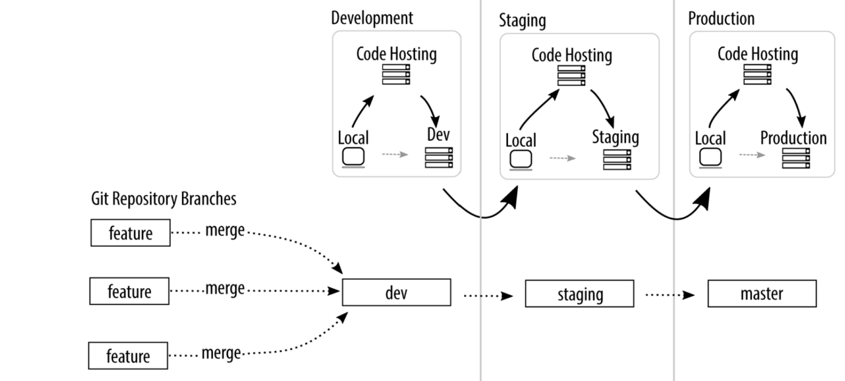
DevOps - BRANCHING STRATEGY - RULES
Rule’s which can be applied to Main & Support branches'
Master
This is the main branch, whose code is deployed in the production environment and being used by the customer in live.
No direct commits are allowed.
It should accept pull requests only from the release branch
Should not have unreleased code [ every commit in master must have a stable release associated ]
The pull request from the release branch should be reviewed and approved by the client/stakeholder/product Owner.
Develop
The code in this branch will be deployed in development environment.
No direct commits are allowed.
It should accept pull requests only from the feature or bugfix branches.
It is the base default branch for feature or bugfix branches.
Release
The code in this branch will be deployed in QA environment
No direct commits are allowed.
It should accept pull request only from the develop branch and it should not accept pull requests from other feature or bugfix branches.
The pull request from the develop branch should be reviewed and approved by the techlead/QA tester.
Bugfix
Any new bugfix should have its own branch created from develop branch.
The naming convention to follow for the bugfix branch is bugfix/$(y) where y denotes the name of the bug to be fixed..
Direct commits are allowed.
We can delete the branch after fixing the bug.
Feature
Any new feature should have its own branch created from develop branch.
The naming convention to follow for the feature branch is feature/$(x) where x denotes the name of the feature to be developed.
Direct commits are allowed only when developer is working on the feature.
Hotfix
Hotfixes are production issues that need an immediate fix before a planned release. The development team creates a hotfix branch from master and applies the appropriate fixes.

Slide 5
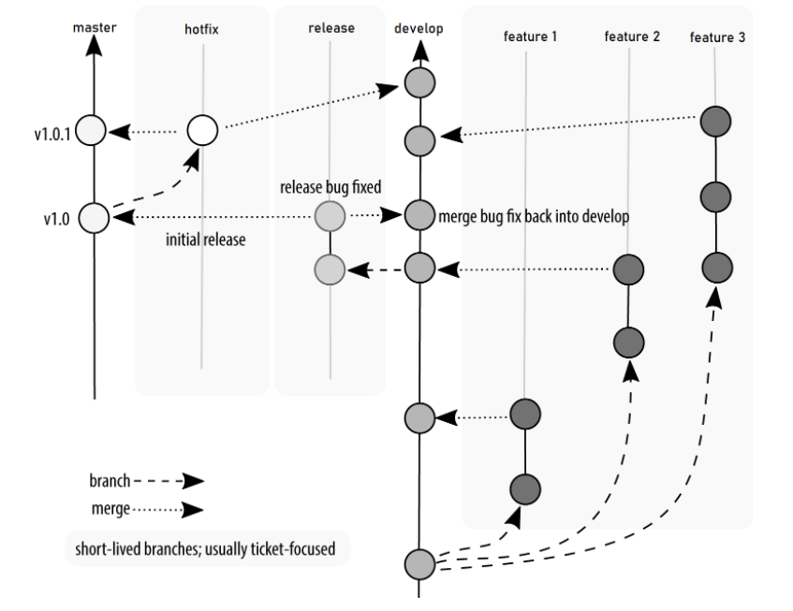
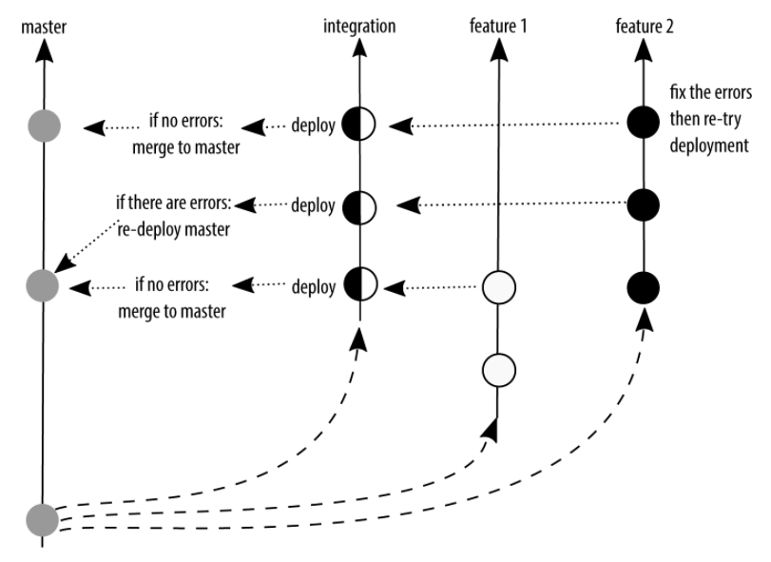
DevOps – GitFlow v/s Trunk Based Development
GitFlow
Trunk Based Development

Slide 6
DevOps – GitFlow | Essential Commands
Commit History
Show all commits, starting with newest (it'll show the hash, author information, date of commit and title of the commit):
$ git log
Show all the commits(it'll show just the commit hash and the commit message):
$ git log --oneline
Show all commits of a specific user:
$ git log --author="username"
Show changes over time for a specific file:
$ git log -p <file>
Display commits that are present only in remote/branch in right side
$ git log --oneline <origin/master>..<remote/master> --left-right
Who changed, what and when in <file>:
$ git blame <file>
Show Reference log:
$ git reflog show
Delete Reference log:
$ git reflog delete
Setup
Show current configuration:
$ git config --list
Show repository configuration:
$ git config --local --list
Show global configuration:
$ git config --global --list
Show system configuration:
$ git config --system --list
Set a name that is identifiable for credit when review version history:
$ git config --global user.name "[firstname lastname]"
Set an email address that will be associated with each history marker:
$ git config --global user.email "[valid-email]"
Set automatic command line coloring for Git for easy reviewing:
$ git config --global color.ui auto
Set global editor for commit
$ git config --global core.editor vi
Create
Clone an existing repository:
There are two ways:
1. Via SSH
$ git clone ssh://user@domain.com/repo.git
2. Via HTTP
$ git clone http://domain.com/user/repo.git
Create a new local repository in the current directory:
$ git init
Create a new local repository in a specific directory:
$ git init <directory>
Undo
Discard all local changes in your working directory:
$ git reset --hard HEAD
Get all the files out of the staging area(i.e. undo the last git add):
$ git reset HEAD
Discard local changes in a specific file:
$ git checkout HEAD <file>
Revert a commit (by producing a new commit with contrary changes):
$ git revert <commit>
Reset your HEAD pointer to a previous commit and discard all changes since then:
$ git reset --hard <commit>
Reset your HEAD pointer to a remote branch current state.
$ git reset --hard <remote/branch> e.g., upstream/master, origin/my-feature
Reset your HEAD pointer to a previous commit and preserve all changes as unstaged changes:
$ git reset <commit>
Reset your HEAD pointer to a previous commit and preserve uncommitted local changes:
$ git reset --keep <commit>
Remove files that were accidentally committed before they were added to .gitignore
$ git rm -r --cached .
$ git add .
$ git commit -m "remove xyz file"
Configuration Files
Repository specific configuration file [--local]:
<repo>/.git/config
User-specific configuration file [--global]:
~/.gitconfig
System-wide configuration file [--system]:
/etc/gitconfig

Slide 7
DevOps – GitFlow | Essential Commands
Local Changes
Changes in working directory:
$ git status
Changes to tracked files:
$ git diff
See changes/difference of a specific file:
$ git diff <file>
Add all current changes to the next commit:
$ git add .
Add some changes in <file> to the next commit:
$ git add -p <file>
Add only the mentioned files to the next commit:
$ git add <filename1> <filename2>
Commit all local changes in tracked files:
$ git commit -a
Commit previously staged changes:
$ git commit
Commit with message:
$ git commit -m 'message here'
Commit skipping the staging area and adding message:
$ git commit -am 'message here'
Commit to some previous date:
$ git commit --date="`date --date='n day ago'`" -am "<Commit Message Here>"
Change last commit: Don't amend published commits!
$ git commit -a --amend
Amend with last commit but use the previous commit log message Don't amend published commits!
$ git commit --amend --no-edit
Change committer date of last commit:
GIT_COMMITTER_DATE="date" git commit --amend
Change Author date of last commit:
$ git commit --amend --date="date"
Move uncommitted changes from current branch to some other branch:
$ git stash
$ git checkout branch2
$ git stash pop
Restore stashed changes back to current branch:
$ git stash apply
Restore particular stash back to current branch:
{stash_number} can be obtained from git stash list
$ git stash apply stash@{stash_number}
Remove the last set of stashed changes:
$ git stash drop
Branches & Tags
List all local branches:
$ git branch
List local/remote branches
$ git branch -a
List all remote branches:
$ git branch -r
Switch HEAD branch:
$ git checkout <branch>
Checkout single file from different branch
$ git checkout <branch> -- <filename>
Create and switch new branch:
$ git checkout -b <branch>
Switch to the previous branch, without saying the name explicitly:
$ git checkout -
Create a new branch from an exiting branch and switch to new branch:
$ git checkout -b <new_branch> <existing_branch>
Checkout and create a new branch from existing commit
$ git checkout <commit-hash> -b <new_branch_name>
Create a new branch based on your current HEAD:
$ git branch <new-branch>
Create a new tracking branch based on a remote branch:
$ git branch --track <new-branch> <remote-branch>
Delete a local branch:
$ git branch -d <branch>
Rename current branch to new branch name
$ git branch -m <new_branch_name>
Force delete a local branch: You will lose unmerged changes!
$ git branch -D <branch>
Mark HEAD with a tag:
$ git tag <tag-name>
Mark HEAD with a tag and open the editor to include a message:
$ git tag -a <tag-name>
Mark HEAD with a tag that includes a message:
$ git tag <tag-name> -am 'message here'
List all tags:
$ git tag
List all tags with their messages (tag message or commit message if tag has no message):
$ git tag -n

Slide 8
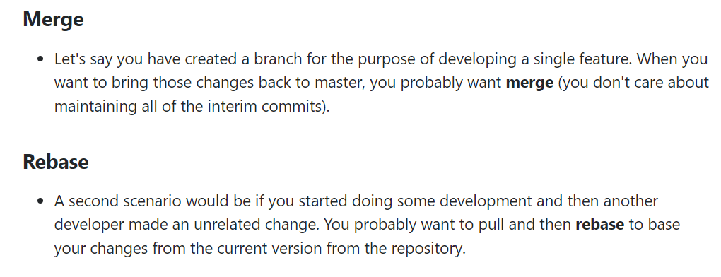
DevOps – GitFlow | Essential Commands
Merge & Rebase
Merge branch into your current HEAD:
$ git merge <branch>
List merged branches
$ git branch --merged
Rebase your current HEAD onto <branch>:
Don't rebase published commit!
$ git rebase <branch>
Abort a rebase:
$ git rebase --abort
Continue a rebase after resolving conflicts:
$ git rebase --continue
Use your editor to manually solve conflicts and (after resolving) mark file as resolved:
$ git add <resolved-file>
$ git rm <resolved-file>
Squashing commits:
$ git rebase -i <commit-just-before-first>
Now replace this,
pick <commit_id>
pick <commit_id2>
pick <commit_id3>
to this,
pick <commit_id>
squash <commit_id2>
squash <commit_id3>
Update & Publish
List all current configured remotes:
$ git remote -v
Show information about a remote:
$ git remote show <remote>
Add new remote repository, named <remote>:
$ git remote add <remote> <url>
Rename a remote repository, from <remote> to <new_remote>:
$ git remote rename <remote> <new_remote>
Remove a remote:
$ git remote rm <remote>
Note: git remote rm does not delete the remote repository from the server. It simply removes the remote and its references from your local repository.
Download all changes from <remote>, but don't integrate into HEAD:
$ git fetch <remote>
Download changes and directly merge/integrate into HEAD:
$ git remote pull <remote> <url>
Get all changes from HEAD to local repository:
$ git pull origin master
Get all changes from HEAD to local repository without a merge:
$ git pull --rebase <remote> <branch>
Publish local changes on a remote:
$ git push <remote> <branch>
Delete a branch on the remote:
$ git push <remote> :<branch> (since Git v1.5.0)
OR
$ git push <remote> --delete <branch> (since Git v1.7.0)
Publish your tags:
$ git push --tags
Configure the merge tool globally to meld (editor)
$ git config --global merge.tool meld
Use your configured merge tool to solve conflicts:
$ git mergetool
Search
A text search on all files in the directory:
$ git grep "Hello"
In any version of a text search:
$ git grep "Hello" v2.5
Show commits that introduced a specific keyword
$ git log -S 'keyword'
Show commits that introduced a specific keyword (using a regular expression)
$ git log -S 'keyword' --pickaxe-regex
Move / Rename
Rename a file: Rename Index.txt to Index.html
$ git mv Index.txt Index.html

Slide 9
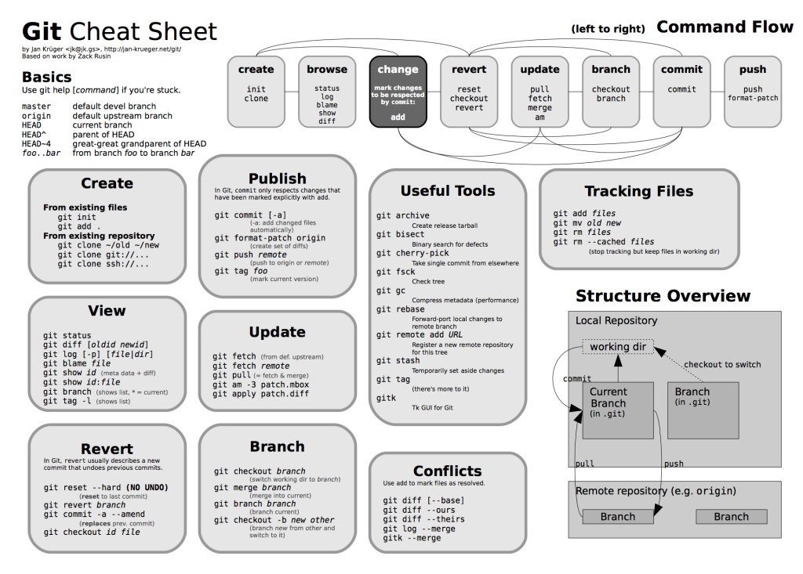




Slide 10

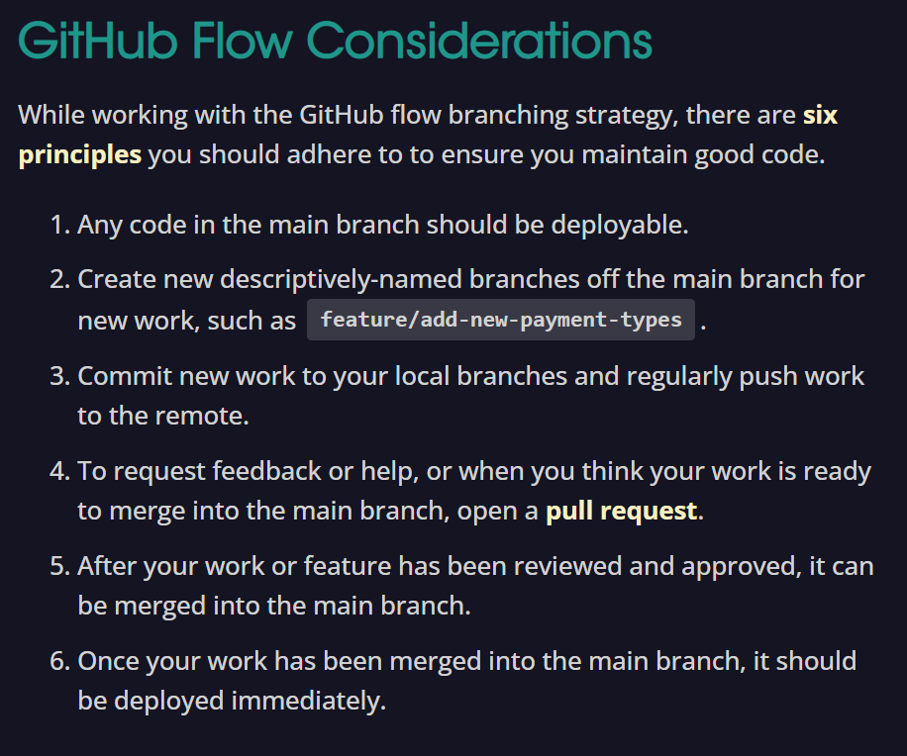
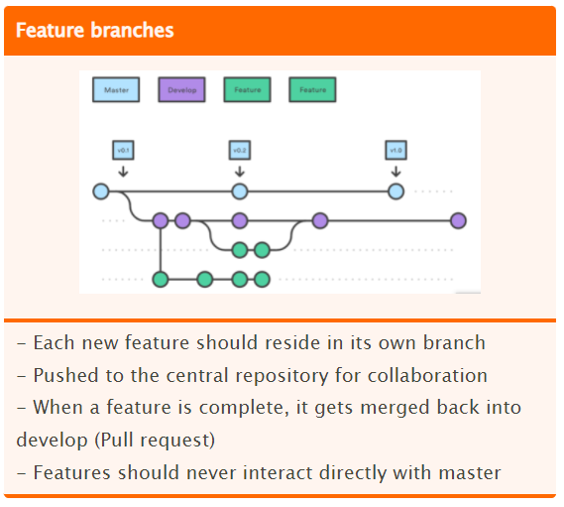
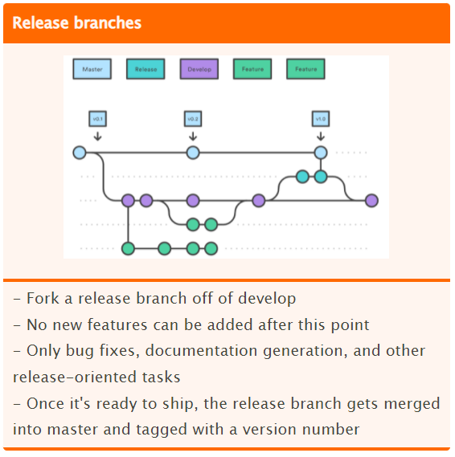
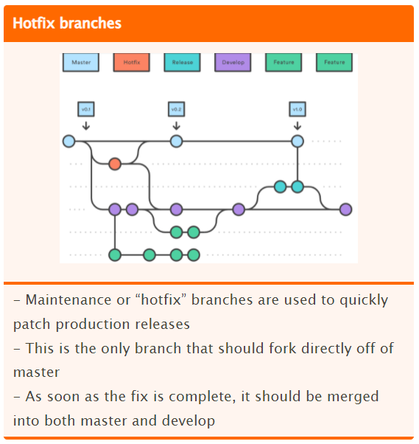
Parallel Development
One of the great things about GitFlow is that it makes parallel development very easy, by isolating new development from finished work. New development (such as features and non-emergency bug fixes) is done in feature branches & is only merged back into main body of code when the developer(s) is happy that the code is ready for release.
Although interruptions are a bad thing, if you are asked to switch from one task to another, all you need to do is commit your changes and then create a new feature branch for your new task. When that task is done, just checkout your original feature branch and you can continue where you left off.
Collaboration
Feature branches also make it easier for two or more developers to collaborate on the same feature, because each feature branch is a sandbox where the only changes are the changes necessary to get the new feature working. That makes it very easy to see and follow what each collaborator is doing.
Support For Emergency Fixes
GitFlow supports hotfix branches - branches made from a tagged release. You can use these to make an emergency change, safe in the knowledge that the hotfix will only contain your emergency fix. There’s no risk that you’ll accidentally merge in new development at the same time.

Slide 11
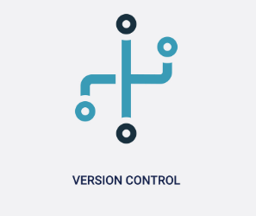
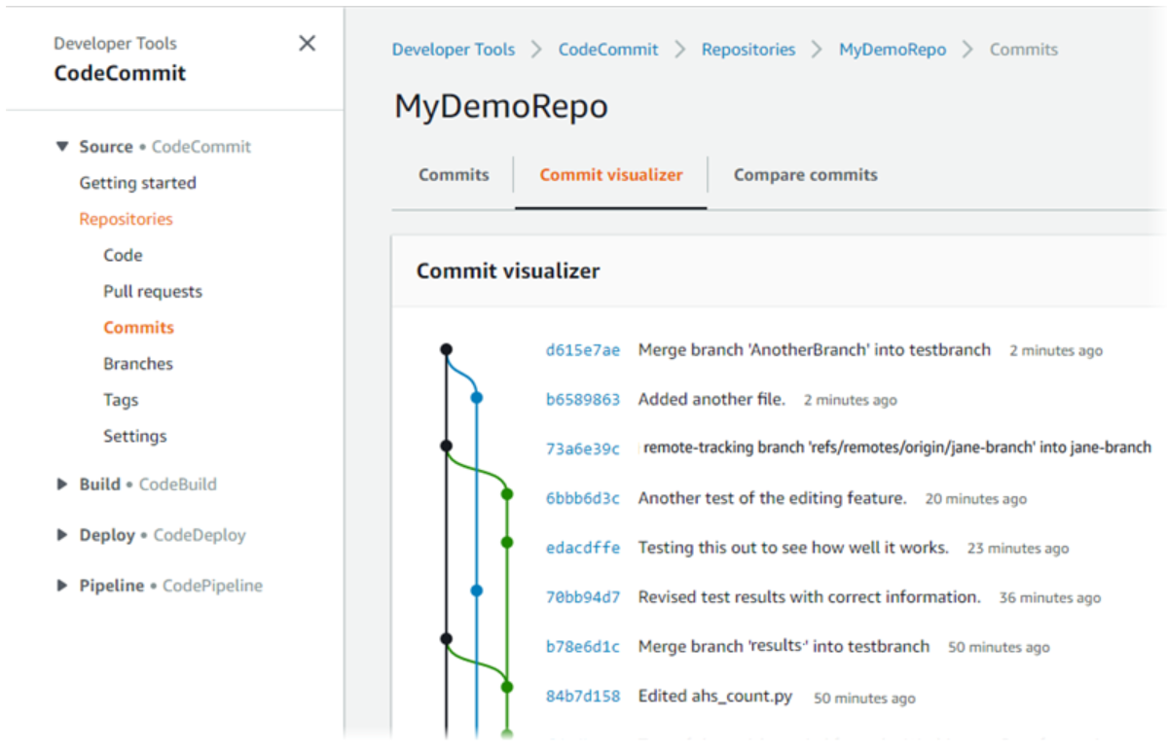

Protecting Code Base
Your code is only as secure as the systems used to create it. As the central point at which your code is stored and managed, it's crucial that the repository is sufficiently secure.
Version control, peer review and built-in auditing are some of the advantages which come with using a code repository. If proper attention is paid to security measures, the benefits of using a repository far outweigh the risks
https://www.atlassian.com/git/tutorials/what-is-version-control
https://medium.com/@vogeleah/protect-your-code-base-214bd9416678
https://medium.com/better-programming/six-rules-for-good-git-hygiene-5006cf9e9e2
https://docs.github.com/en/github/administering-a-repository/about-protected-branches
https://docs.github.com/en/github/administering-a-repository/configuring-protected-branches
https://docs.github.com/en/github/administering-a-repository/about-required-status-checks
https://docs.github.com/en/github/administering-a-repository/enabling-required-status-checks
https://www.perforce.com/blog/vcs/what-is-version-control

